Slide 1
Test Driven Development (TDD)
Ryan Bartling

Slide 2
Agenda
Why?
What?
How?
Notes:
Questions to answer

Slide 3
Agenda
What?
How?
Why?
Notes:
In no particular order

Slide 4
Test
Driven
Development
Notes:
Where should the emphasis be?

Slide 5
Test
Driven
Development
Notes:
Most would emphasize the testing of the code.
If this were the driving factor, it wouldn’t matter when or how you test, so long as you test.

Slide 6
Test
Driven
Development
Notes:
The important point is that you are taking your code for a test drive.
You state what you want your code to do, and then you make it do that.
One small test at a time.

Slide 7
An example
Notes:
Okay, here’s an example ☺
The problem I needed to solve:
Needed a steady heart rate indicator.
Solution, have a rolling counter for heart beats over the last 20 seconds.

Slide 8
Windowed Event Counter
0

Slide 9
Windowed Event Counter
3

Slide 10
Windowed Event Counter
5

Slide 11
Windowed Event Counter
2

Slide 12
Tests
Starting a measurement window should return okay
Trying to start a started WEC should give an error
Stopping a WEC that’s not started should return err
Stopping a started WEC should be okay
TimeGet should return elapsed time
TimeGet should work regardless of the start time
TimeGet should be 0 before WEC is first started
TimeGet result shouldn’t change once WEC stops
Setting limit should be okay when WEC stopped
Setting limit should change the window limit

Slide 13
First test
/// @file test_windowed_event_counter.c
#include “unity.h”
#include “windowed_event_counter.h”
void test_WindowStart_should_returnOkay_when_moduleIsNotStarted(void) {
TEST_ASSERT_EQUAL_MESSAGE(WEC_OKAY, WEC_WindowStart(0U),
"Expected WEC_OKAY");
}
int main(void) {
UNITY_BEGIN();
UN_TEST(test_WindowStart_should_returnOkay_when_moduleIsNotStarted);
return UNITY_END();
}
Notes:
Using unity framework.
There are many frameworks, but this is the one used at the time.
These days, I prefer Catch2.

Slide 14
First test
/// @file test_windowed_event_counter.c
#include “unity.h”
#include “windowed_event_counter.h”
void test_WindowStart_should_returnOkay_when_moduleIsNotStarted(void) {
TEST_ASSERT_EQUAL_MESSAGE(WEC_OKAY, WEC_WindowStart(0U),
"Expected WEC_OKAY");
}
int main(void) {
UNITY_BEGIN();
UN_TEST(test_WindowStart_should_returnOkay_when_moduleIsNotStarted);
return UNITY_END();
}
Notes:
Prefix test functions with “test_”

Slide 15
First test
/// @file test_windowed_event_counter.c
#include “unity.h”
#include “windowed_event_counter.h”
void test_WindowStart_should_returnOkay_when_moduleIsNotStarted(void) {
TEST_ASSERT_EQUAL_MESSAGE(WEC_OKAY, WEC_WindowStart(0U),
"Expected WEC_OKAY");
}
int main(void) {
UNITY_BEGIN();
UN_TEST(test_WindowStart_should_returnOkay_when_moduleIsNotStarted);
return UNITY_END();
}
Notes:
Use the name of the function under test

Slide 16
First test
/// @file test_windowed_event_counter.c
#include “unity.h”
#include “windowed_event_counter.h”
void test_WindowStart_should_returnOkay_when_moduleIsNotStarted(void) {
TEST_ASSERT_EQUAL_MESSAGE(WEC_OKAY, WEC_WindowStart(0U),
"Expected WEC_OKAY");
}
int main(void) {
UNITY_BEGIN();
UN_TEST(test_WindowStart_should_returnOkay_when_moduleIsNotStarted);
return UNITY_END();
}
Notes:
Describe what the function should do

Slide 17
First test
/// @file test_windowed_event_counter.c
#include “unity.h”
#include “windowed_event_counter.h”
void test_WindowStart_should_returnOkay_when_moduleIsNotStarted(void) {
TEST_ASSERT_EQUAL_MESSAGE(WEC_OKAY, WEC_WindowStart(0U),
"Expected WEC_OKAY");
}
int main(void) {
UNITY_BEGIN();
UN_TEST(test_WindowStart_should_returnOkay_when_moduleIsNotStarted);
return UNITY_END();
}
Notes:
And under what conditions the function should do it.

Slide 18
First test
/// @file test_windowed_event_counter.c
#include “unity.h”
#include “windowed_event_counter.h”
void test_WindowStart_should_returnOkay_when_moduleIsNotStarted(void) {
TEST_ASSERT_EQUAL_MESSAGE(WEC_OKAY, WEC_WindowStart(0U),
"Expected WEC_OKAY");
}
int main(void) {
UNITY_BEGIN();
UN_TEST(test_WindowStart_should_returnOkay_when_moduleIsNotStarted);
return UNITY_END();
}
Notes:
Unity has a number of test assertions

Slide 19
First test
/// @file test_windowed_event_counter.c
#include “unity.h”
#include “windowed_event_counter.h”
void test_WindowStart_should_returnOkay_when_moduleIsNotStarted(void) {
TEST_ASSERT_EQUAL_MESSAGE(WEC_OKAY, WEC_WindowStart(0U),
"Expected WEC_OKAY");
}
int main(void) {
UNITY_BEGIN();
UN_TEST(test_WindowStart_should_returnOkay_when_moduleIsNotStarted);
return UNITY_END();
}
Notes:
The first statement is what we expect to see

Slide 20
First test
/// @file test_windowed_event_counter.c
#include “unity.h”
#include “windowed_event_counter.h”
void test_WindowStart_should_returnOkay_when_moduleIsNotStarted(void) {
TEST_ASSERT_EQUAL_MESSAGE(WEC_OKAY, WEC_WindowStart(0U),
"Expected WEC_OKAY");
}
int main(void) {
UNITY_BEGIN();
UN_TEST(test_WindowStart_should_returnOkay_when_moduleIsNotStarted);
return UNITY_END();
}
Notes:
The second is the expression or value under test.

Slide 21
First test
/// @file test_windowed_event_counter.c
#include “unity.h”
#include “windowed_event_counter.h”
void test_WindowStart_should_returnOkay_when_moduleIsNotStarted(void) {
TEST_ASSERT_EQUAL_MESSAGE(WEC_OKAY, WEC_WindowStart(0U),
"Expected WEC_OKAY");
}
int main(void) {
UNITY_BEGIN();
UN_TEST(test_WindowStart_should_returnOkay_when_moduleIsNotStarted);
return UNITY_END();
}
Notes:
Test assertions that end with _MESSAGE allow the user to specify a custom message to allow the test to be more expressive.

Slide 22
First test
/// @file test_windowed_event_counter.c
#include “unity.h”
#include “windowed_event_counter.h”
void test_WindowStart_should_returnOkay_when_moduleIsNotStarted(void) {
TEST_ASSERT_EQUAL_MESSAGE(WEC_OKAY, WEC_WindowStart(0U),
"Expected WEC_OKAY");
}
int main(void) {
UNITY_BEGIN();
UN_TEST(test_WindowStart_should_returnOkay_when_moduleIsNotStarted);
return UNITY_END();
}
Notes:
Main acts as our test runner.
There are automation tools for generating main, but we’ll go over those another time.

Slide 23
Compile fails!

Slide 24
First test
/// @file test_windowed_event_counter.c
#include “unity.h”
#include “windowed_event_counter.h”
void test_WindowStart_should_returnOkay_when_moduleIsNotStarted(void) {
TEST_ASSERT_EQUAL_MESSAGE(WEC_OKAY, WEC_WindowStart(0U),
"Expected WEC_OKAY");
}
int main(void) {
UNITY_BEGIN();
UN_TEST(test_WindowStart_should_returnOkay_when_moduleIsNotStarted);
return UNITY_END();
}
Notes:
Don’t have windowed_event_counter.h
WEC_WindowStart() is not declared.
WEC_OKAY is undeclared.

Slide 25
First test
/// @file windowed_event_counter.h
typedef enum {
WEC_OKAY = 0, ///< Everything’s AyOkay!
WEC_ERROR, ///< Default error. Shouldn’t get returned.
} WEC_ERROR_T;
typedef uint32_t WEC_TIME_T;
WEC_ERROR_T WEC_WindowStart(WEC_TIME_T startTime);
Notes:
Still doesn’t compile.
Now we have a linker error because WEC_WindowStart is not defined.

Slide 26
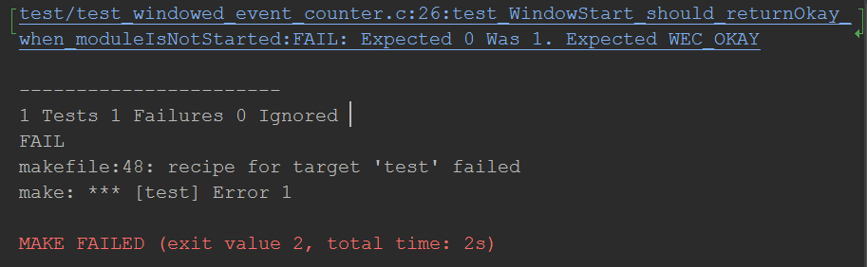
First test
/// @file windowed_event_counter.c
#include “windowed_event_counter.h”
WEC_ERROR_T WEC_WindowStart(WEC_TIME_T startTime){
return
}
WEC_ERROR;
Notes:
Change the return value to

Slide 27
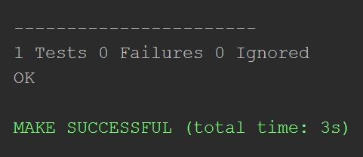
First test
/// @file windowed_event_counter.c
#include “windowed_event_counter.h”
WEC_ERROR_T WEC_WindowStart(WEC_TIME_T startTime){
return
}
WEC_OKAY;
Notes:
OKAY!
Fake it ‘till you make it.
Write the simplest code that passes the tests.

Slide 28
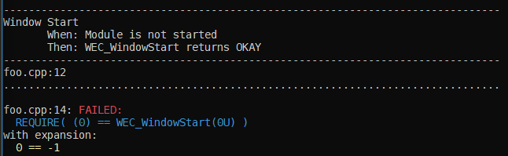
First test
#include "windowed_event_counter.h"
#include <catch2/catch.hpp>
TEST_CASE("Window Start", "[wec]")
{
WHEN("Module is not started")
{
THEN("WEC_WindowStart returns OKAY")
{
REQUIRE(WEC_OKAY, WEC_WindowStart(0U));
}
}
}
Notes:
Main acts as our test runner.
There are automation tools for generating main, but we’ll go over those another time.

Slide 29
Tests
Starting a measurement window should return okay
Trying to start a started WEC should give an error
Stopping a WEC that’s not started should return err
Stopping a started WEC should be okay
TimeGet should return elapsed time
TimeGet should work regardless of the start time
TimeGet should be 0 before WEC is first started
TimeGet result shouldn’t change once WEC stops
Setting limit should be okay when WEC stopped
Setting limit should change the window limit

Slide 30
Tests
Starting a measurement window should return okay
Trying to start a started WEC should give an error
Stopping a WEC that’s not started should return err
Stopping a started WEC should be okay
TimeGet should return elapsed time
TimeGet should work regardless of the start time
TimeGet should be 0 before WEC is first started
TimeGet result shouldn’t change once WEC stops
Setting limit should be okay when WEC stopped
Setting limit should change the window limit

Slide 31
TDD State Machine
Have a list of tests
Out of tests to write
Test Chosen
Write the test
Choose a test
DRY
Doesn’t compile
Refactor
Make it compile
Test passes
Doesn’t Link
Make the test pass
Make it link
It compiles
Notes:
Test driven development for embedded developers p. 46

Slide 32
Yeah, but your function doesn’t do anything

Slide 33
Second Test
/// @file test_windowed_event_counter.c
void test_WindowStart_should_returnAlreadyStarted_when_moduleIsStarted(void) {
TEST_ASSERT_EQUAL(WEC_OKAY, WEC_WindowStart(0U));
TEST_ASSERT_EQUAL_MESSAGE(WEC_ALREADY_STARTED, WEC_WindowStart(0U),
"Expected WEC_ALREADY_STARTED");
}
/// @file windowed_event_counter.h
typedef enum {
WEC_OKAY = 0, ///< Everything’s AyOkay!
WEC_ERROR, ///< Default error. Shouldn’t get returned.
WEC_ALREADY_STARTED, ///< Try calling WEC_WindowStop() and try again
} WEC_ERROR_T;
Doesn’t Compile

Slide 34
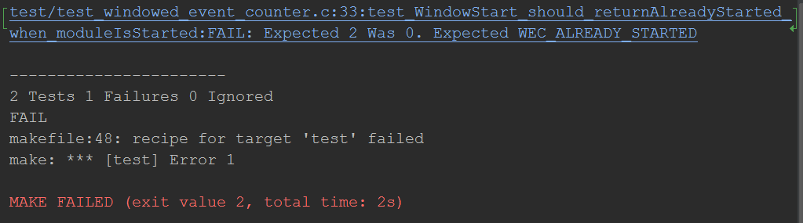
Second Test

Slide 35
Second Test
/// @file windowed_event_counter.c
#include “windowed_event_counter.h”
/// Indicates when window is started and running
static bool WEC_started;
WEC_ERROR_T WEC_WindowStart(WEC_TIME_T startTime) {
if (true == WEC_started) {
return WEC_ALREADY_STARTED;
}
WEC_started = true;
return WEC_OKAY;
}

Slide 36
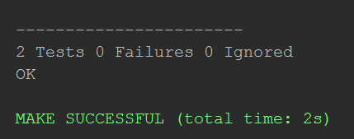
Second Test

Slide 37
Tests
Starting a measurement window should return okay
Trying to start a started WEC should give an error
Stopping a WEC that’s not started should return err
Stopping a started WEC should be okay
TimeGet should return elapsed time
TimeGet should work regardless of the start time
TimeGet should be 0 before WEC is first started
TimeGet result shouldn’t change once WEC stops
Setting limit should be okay when WEC stopped
Setting limit should change the window limit

Slide 38
Tests
Starting a measurement window should return okay
Trying to start a started WEC should give an error
Stopping a WEC that’s not started should return err
Stopping a started WEC should be okay
TimeGet should return elapsed time
TimeGet should work regardless of the start time
TimeGet should be 0 before WEC is first started
TimeGet result shouldn’t change once WEC stops
Setting limit should be okay when WEC stopped
Setting limit should change the window limit

Slide 39
TDD State Machine
Write the test
Choose a test
Refactor
Make it compile
Make the test pass
Make it link
Notes:
Test driven development for embedded developers p. 46

Slide 40
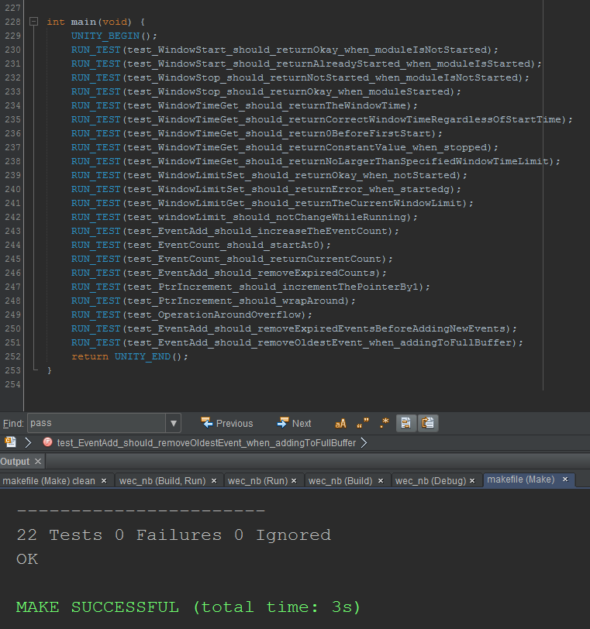
Notes:
Keep looping through the TDD state machine
Eventually get a decent number of tests
The last test refers to a buffer overflow condition

Slide 41
EventAdd
WEC_COUNT_T WEC_EventAdd(WEC_TIME_T eventTime) {
WEC_EventExpire(eventTime);
WEC_count++;
if (WEC_EVENT_BUFFER_SIZE < WEC_count) { // Check for overflow
WEC_EventOldestRemove();
}
WEC_startTime = WEC_StartTimeUpdate(eventTime);
*WEC_eventBufferHead = eventTime;
WEC_eventBufferHead = WEC_PtrIncrement(WEC_eventBufferHead);
return WEC_count;
}

Slide 42
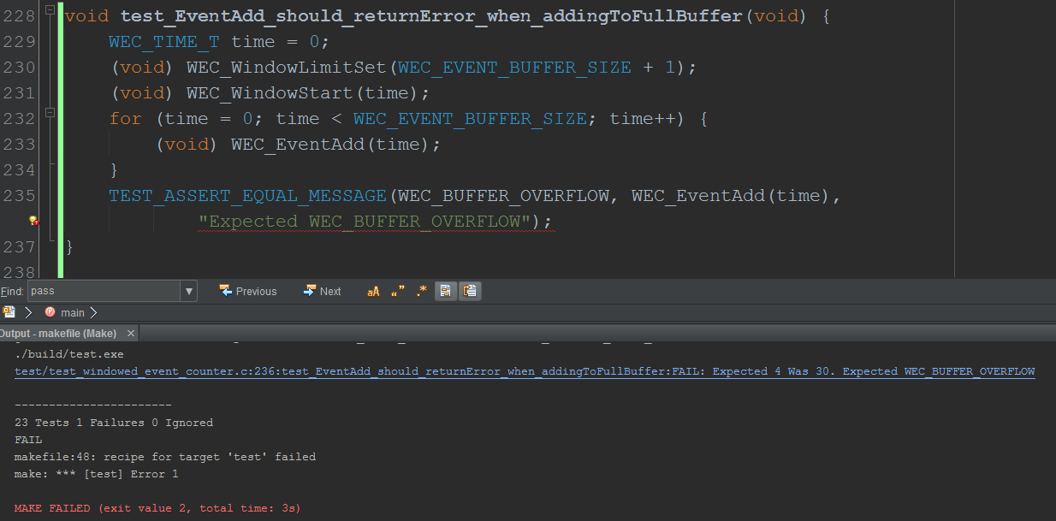
Notes:
So, added a test to say it should return the error. It failed

Slide 43
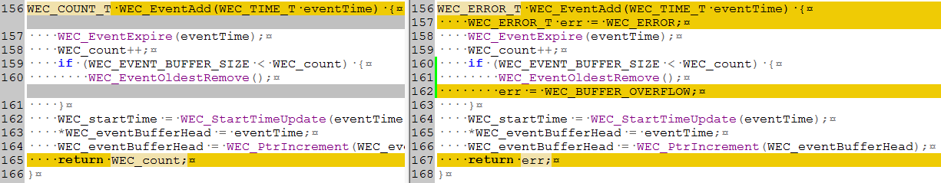
Update EventAdd
Notes:
Fixed the code.
Changed the return type.
Added and initialized err var.
Changed return.
Ran test (still fails).
Updated err in overflow check block.

Slide 44
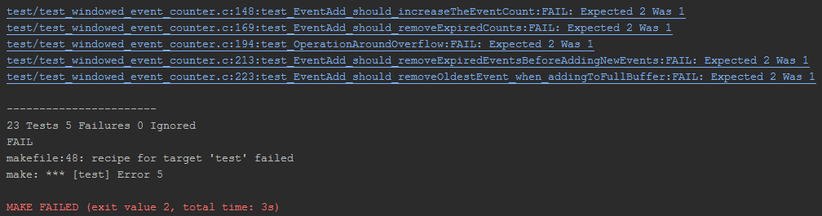
Notes:
Run test and we have a list of things to fix.

Slide 45
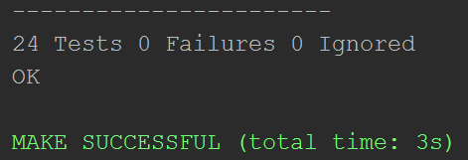
Done!

Slide 46
Defects Vs Productivity
Microsoft (2006)
Non-TDD 2.6x defects, TDD 35% longer
Non-TDD 4.2x defects, TDD 15% longer
S. Yenduri
Non-TDD 2.2x defects, Non-TDD 75% longer
IBM (2003)
50% reduction defects, Project “on-time”
Others
0-60% reduction defects
15% faster – 45% slower
Notes:
https://www.microsoft.com/en-us/research/group/empirical-software-engineering-group-ese/
http://citeseerx.ist.psu.edu/viewdoc/download?doi=10.1.1.94.9442&rep=rep1&type=pdf
http://citeseerx.ist.psu.edu/viewdoc/download?doi=10.1.1.93.1314&rep=rep1&type=pdf

Slide 47
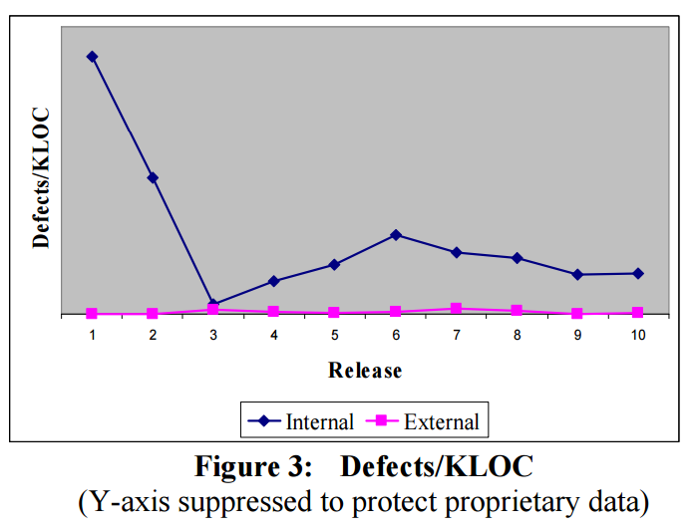
Sustainability
IBM (2007)
Five year case study
40% lower than previous non-TDD release
Notes:
http://collaboration.csc.ncsu.edu/laurie/Papers/agile07.pdf

Slide 48
What about bugs we do find?

Slide 49
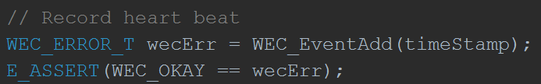
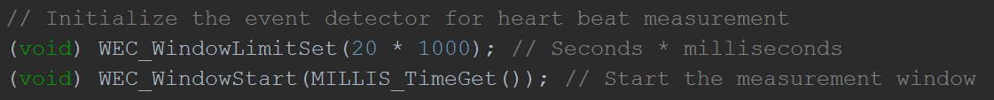

Slide 50


Slide 51
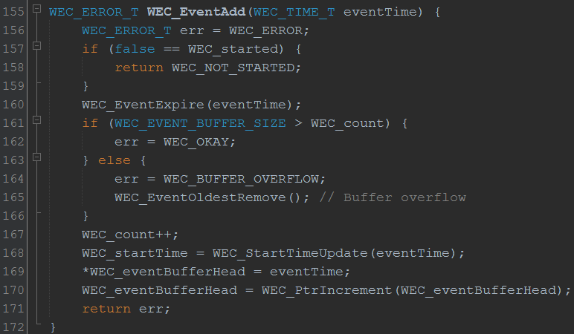

Slide 52
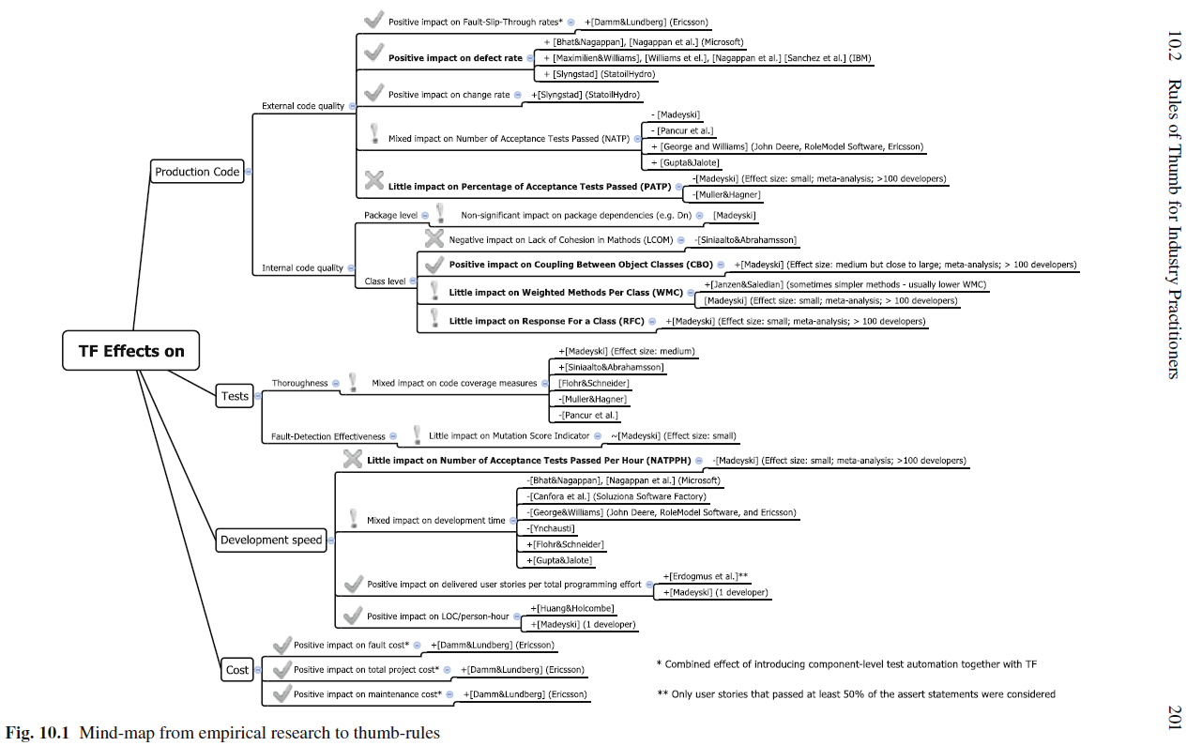
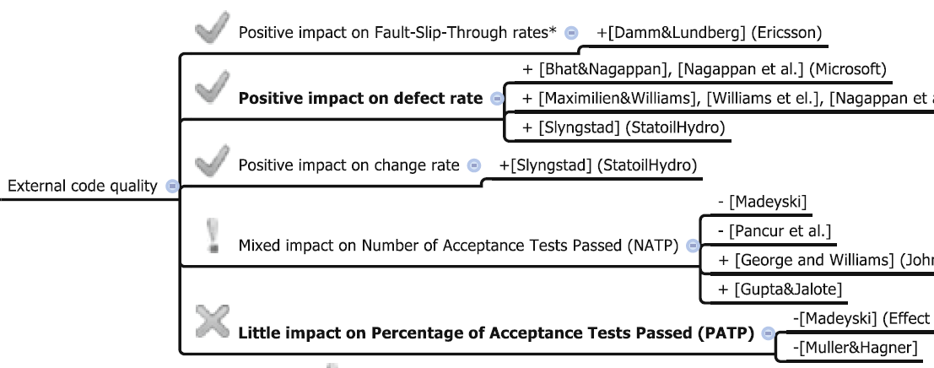

Slide 53
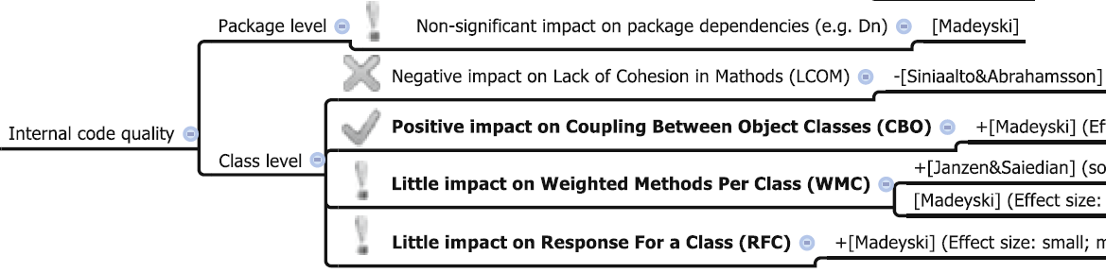

Slide 54
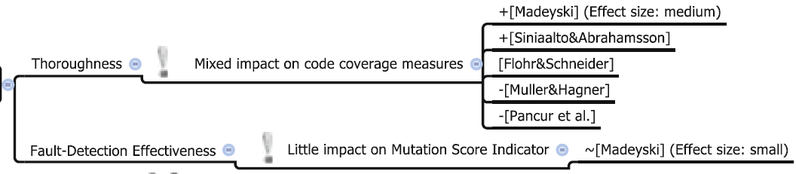

Slide 55
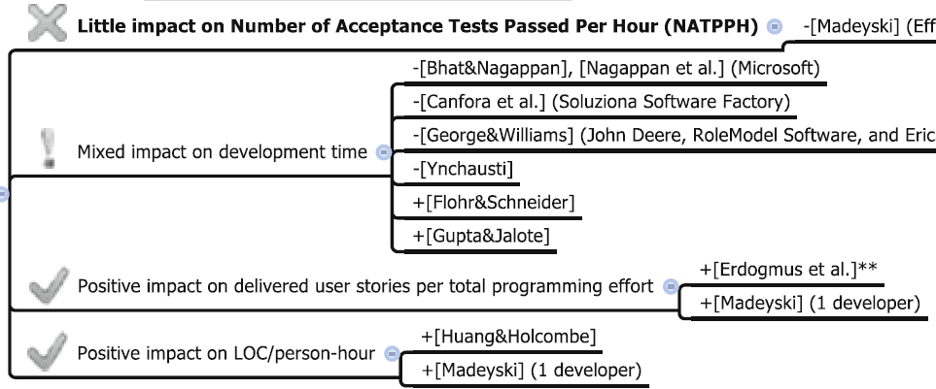

Slide 56
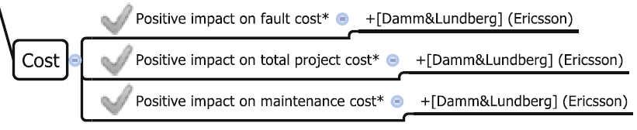

Slide 57
Questions?

